Slide 1

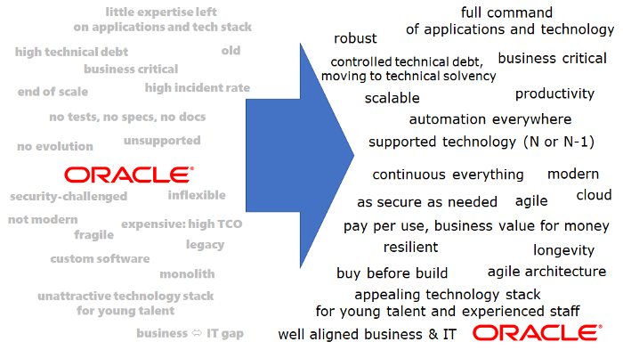
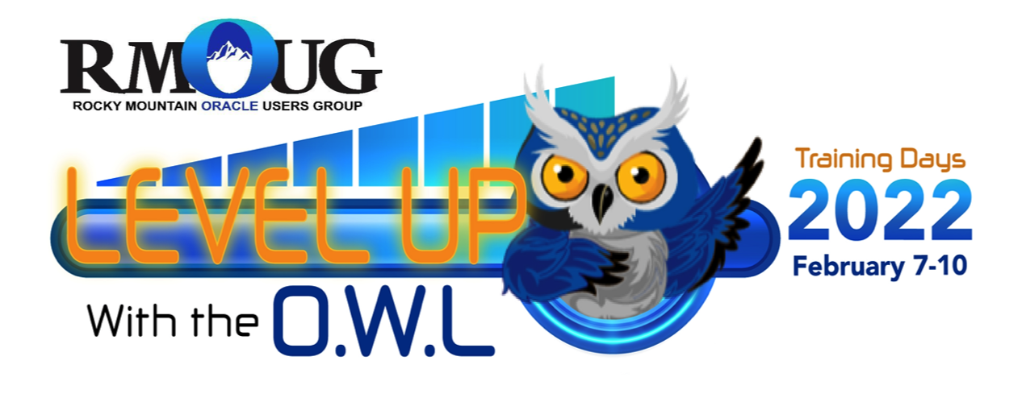
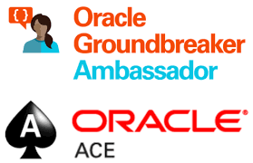
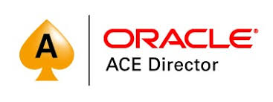
Help me move away from Oracle
Lucas Jellema Architect & CTO AMIS | Conclusion
Notes:
https://medium.com/real-vox/what-if-companies-say-help-me-move-away-from-oracle-ffbbc95afc4f

Slide 2




Lucas Jellema CTO for AMIS | Conclusion Cloud Solution Architect
lucas.jellema@amis.nl | technology.amis.nl | @lucasjellema | lucas-jellema

Slide 3
Who Am I?
Started at and with Oracle in 1994
Oracle Database 7, PL/SQL, Forms, Reports, Case 5.0/5.1 & Designer/2000
Since 2002 working at AMIS | Conclusion
Worked with > 50 companies
data, end user applications, integration, agile, cloud, DevOps, IoT
(almost) always Oracle technology
Last few years: Help me!

Slide 4


Who is asking? Why?
Oracle License Management Service

Slide 5
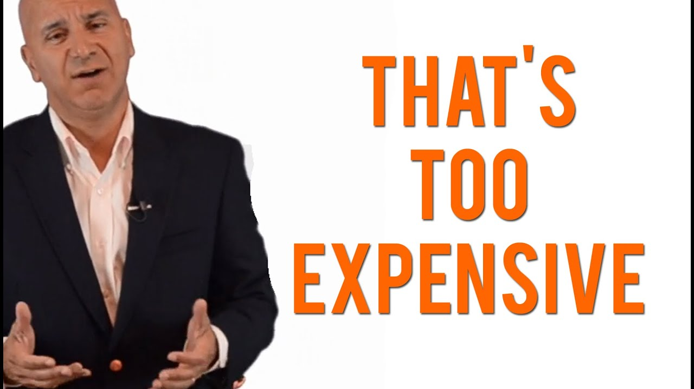

Slide 6
Expensive is subjective
Cost > Benefits
or
Cost = operating expenses + management costs + maintenance costs
Cost of Oracle solution >> Cost of alternative solution

Slide 7
Migration makes financial sense?
( Current Yearly Solution Cost — Post Migration Yearly Solution Cost ) * 5 years >> migration costs
migration costs = requirement analysis + design + implementation + test + train + risk mitigation + …
consider additional post migration benefits

Slide 8

What is meant?
Move away from …
but: where to?

Slide 9
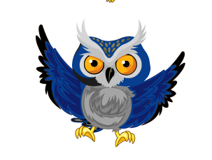
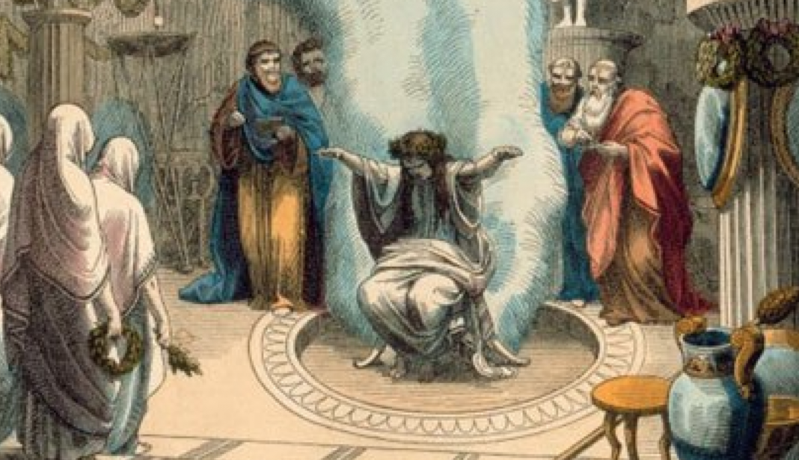
What is meant?
Move away from …
but: where to?
And what is “Oracle”?
why specifically move away from Oracle?

Slide 10
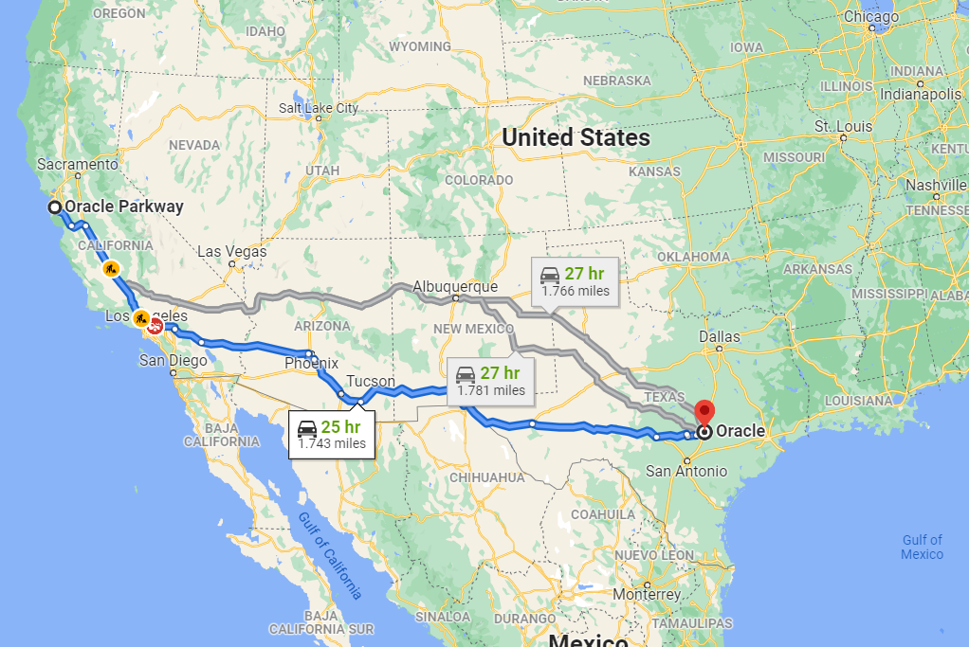
Oracle moving away from Oracle

Slide 11
What is Oracle?

Slide 12
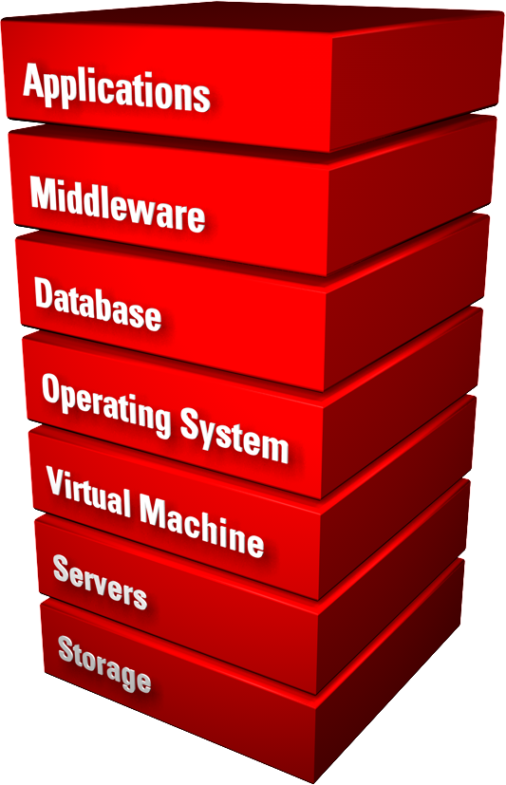
What is Oracle?

Slide 13
What is Oracle?

Slide 14
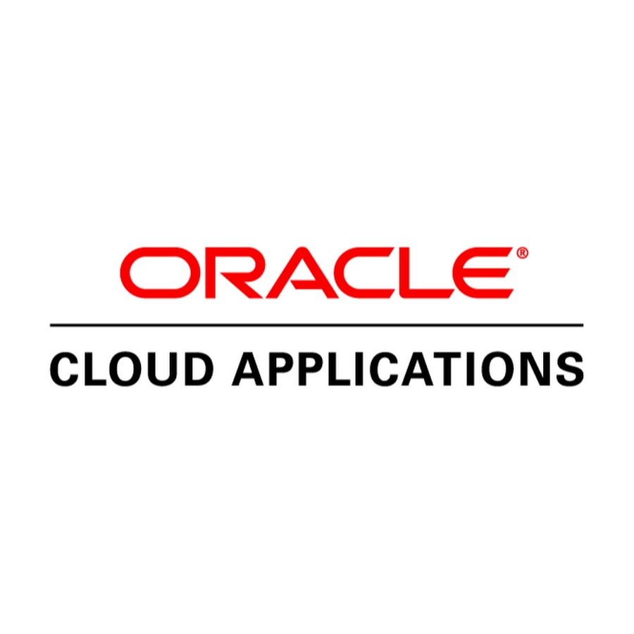
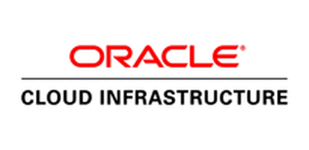
What is Oracle?

Slide 15
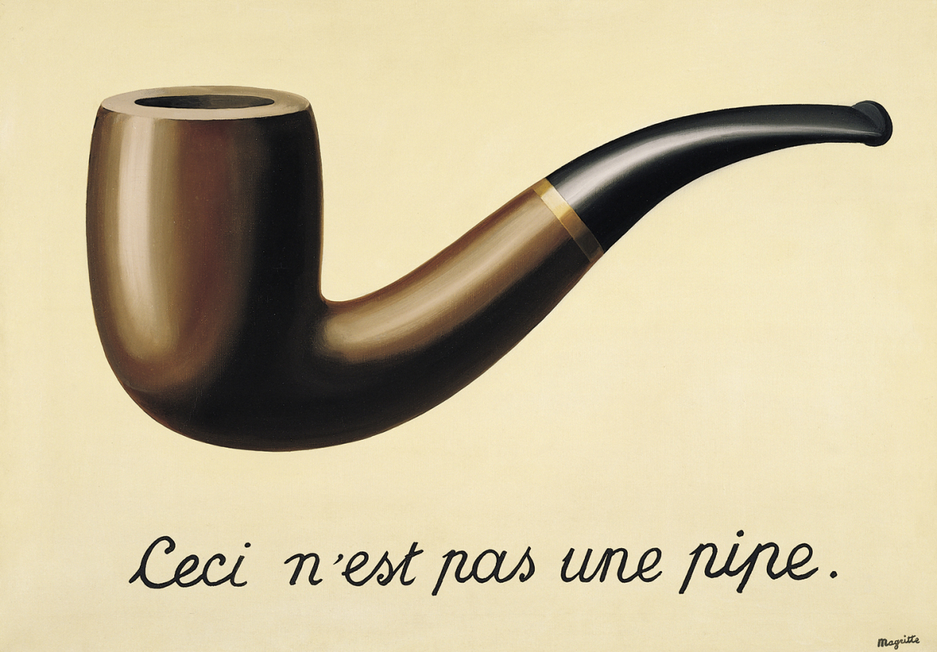
Ce ci

Slide 16
Ce ci
Ceci n’est pas un database

Slide 17
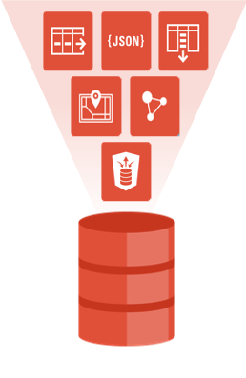
Oracle Database
Is much more than just a relational store of data and SQL query engine
Application Platform
PL/SQL
Stored Java
MLE (multi language engine)
Embedded PL/SQL Gateway, ORDS
APEX
Oracle Database features
Audit
Virtual Private Database
Edition Based Redefinition
Flashback
Spatial and Graph
Advanced Analytics and Machine Learning
…
<> || >> PostgreSQL, MySQL, SQL Server, AWS RDS, NoSQL

Slide 18

Oracle in your organization also includes
Tools
Processes
People, skills and knowledge (and feelings)

Slide 19

Early ‘90s

Slide 20
Before…
Apps (& Mobile Phones)
Internet
Agile
GB
Virtualization
eBusiness Suite (but SAP was there)
Linux
NoSQL
Open Source
Solid State Drive
Cloud
Internet of Things
Climate Change
Metaverse

Slide 21
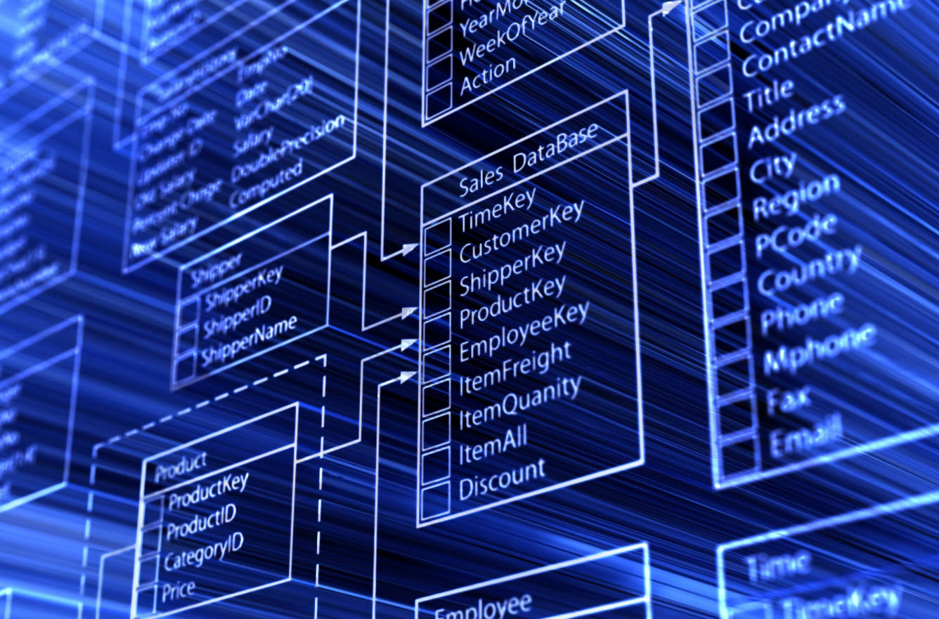
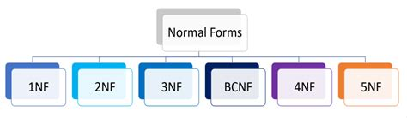
Era of
Relational Database Management System (RDBMS) and SQL
(System R,) Oracle, INGRESS, Paradox, FoxPro, Sybase, DB2, Informix, SQL Server
First rollout of IT in mid-size organizations and across all industries
initially terminals, then PCs and subsequently Windows GUI & mouses (two tier Client/Server)
much custom development (hardly any COTS available)
ERD, Enterprise Datamodel and Enterprise [wide] Database
normalization

Slide 22
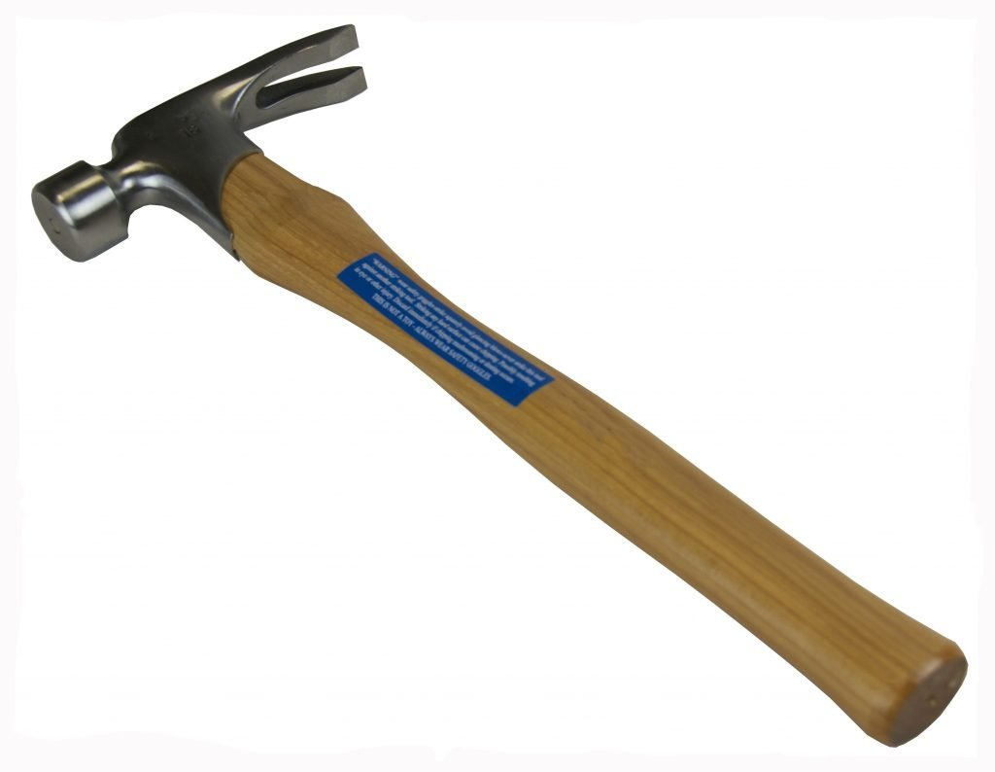

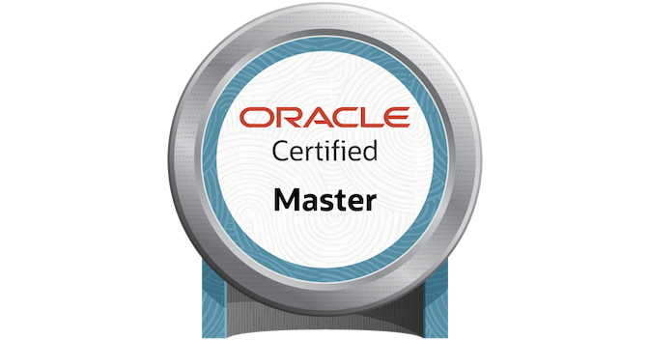
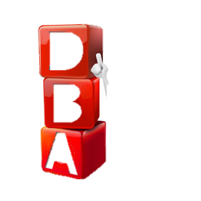
Era of
Strong integrity rules – implemented through constraints
Fat Database – heaps of PL/SQL (triggers & packages)
Applications consisted of:
Oracle Database, PL/SQL, Oracle Forms, Oracle Reports
Monolith – avant la lettre
The DBA ruled supreme
guardians of data model, data, database
Companies gaining competitive edge on cutting (& bleeding) technology edge

Slide 23



Companies gaining competitive advantage

Slide 24
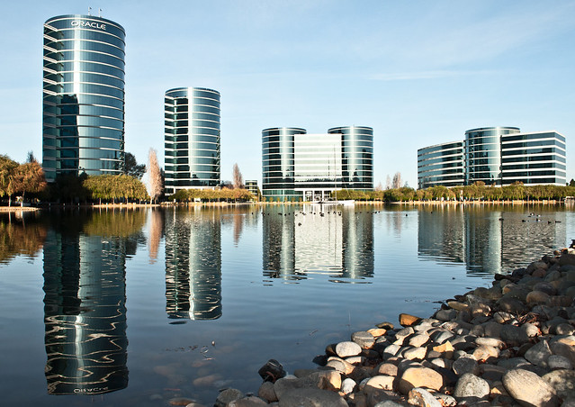
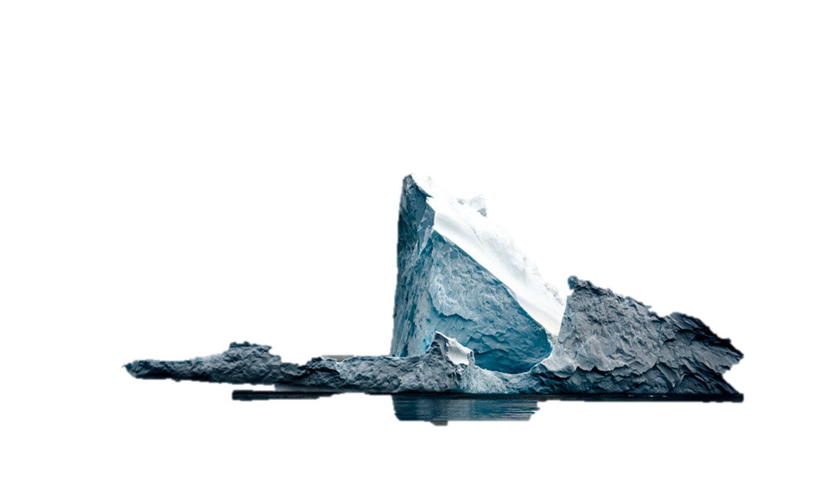

Slide 25

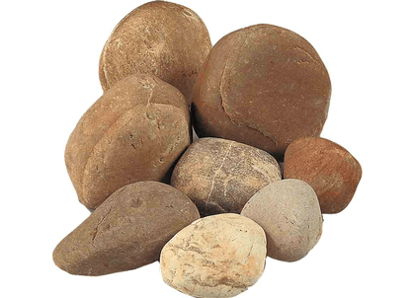
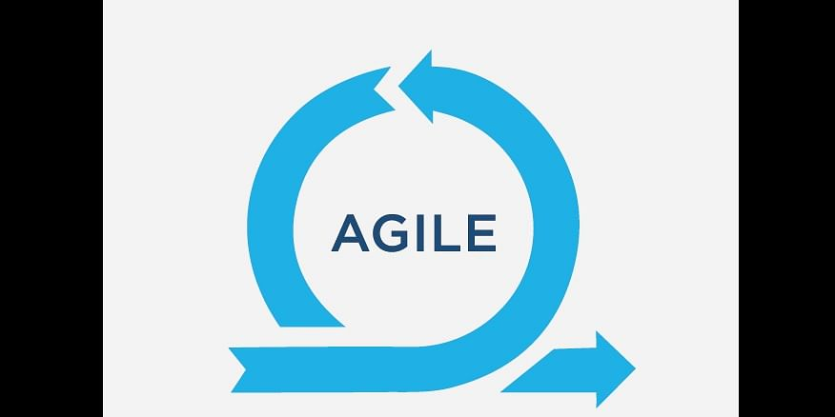


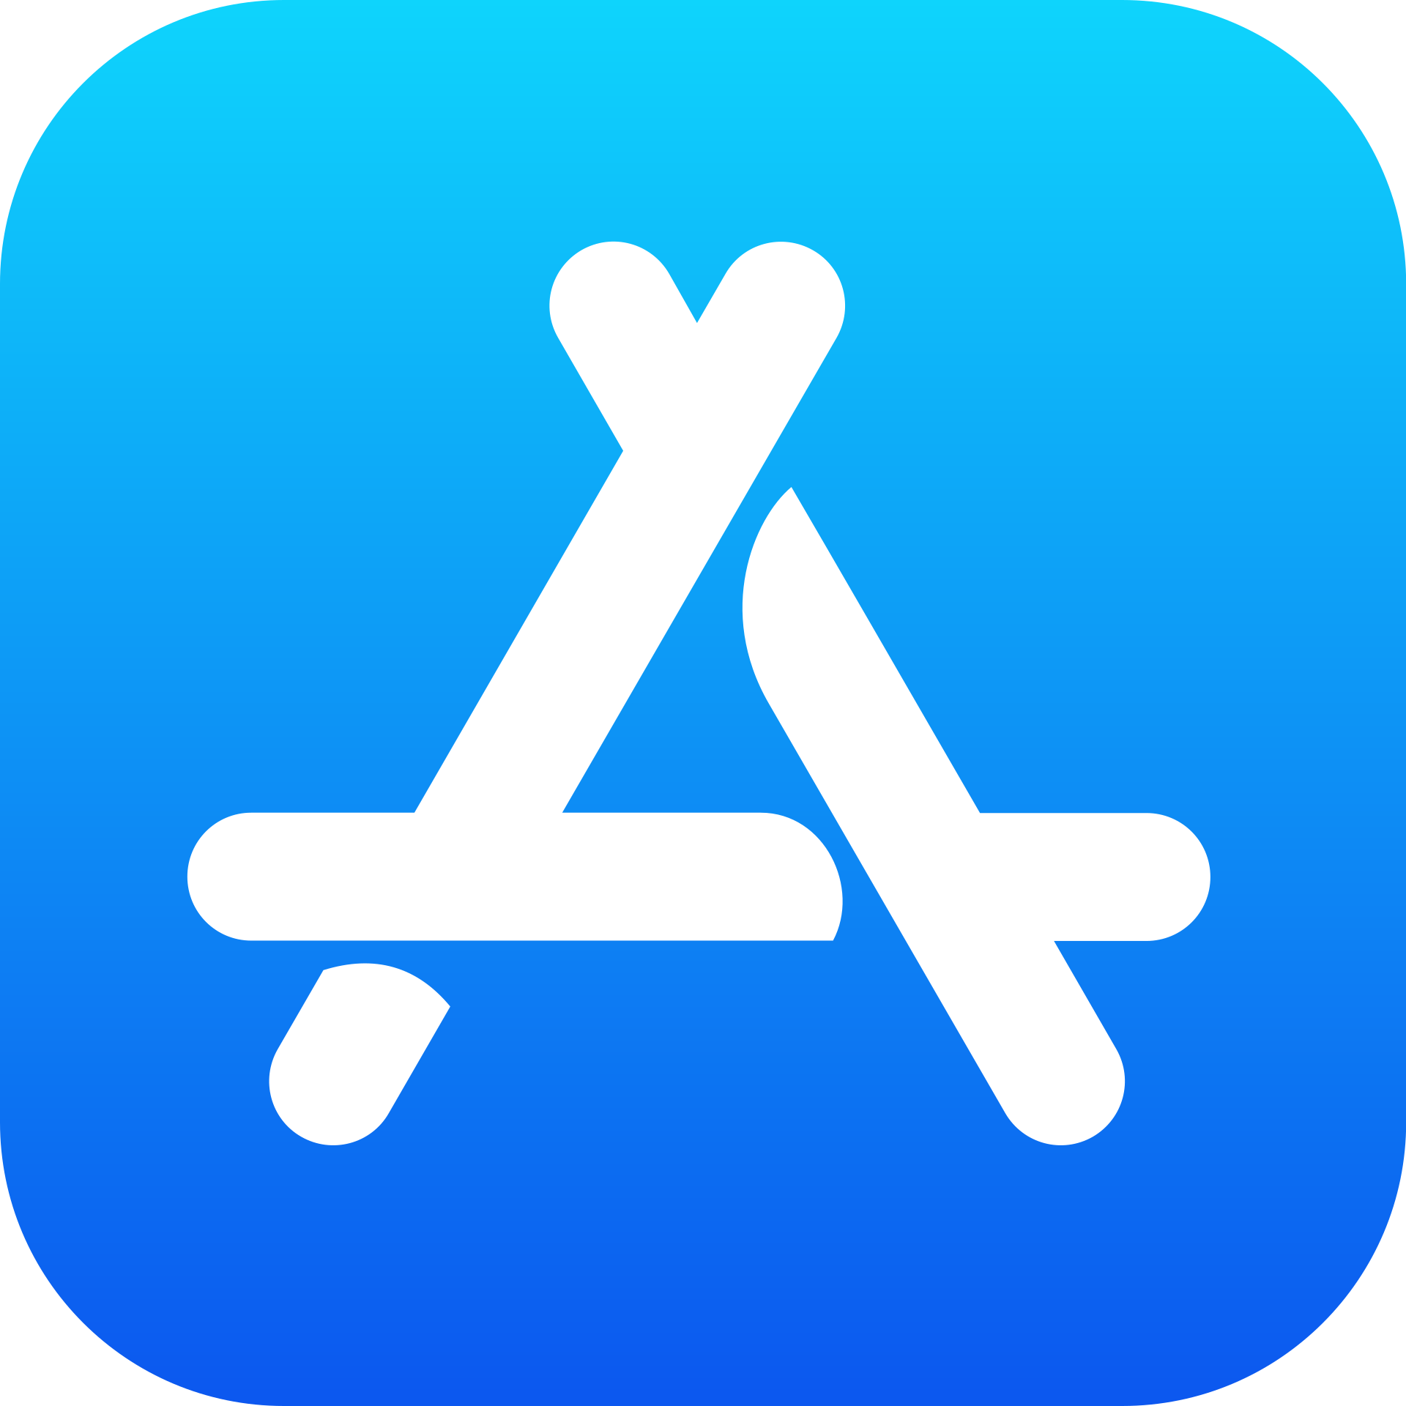



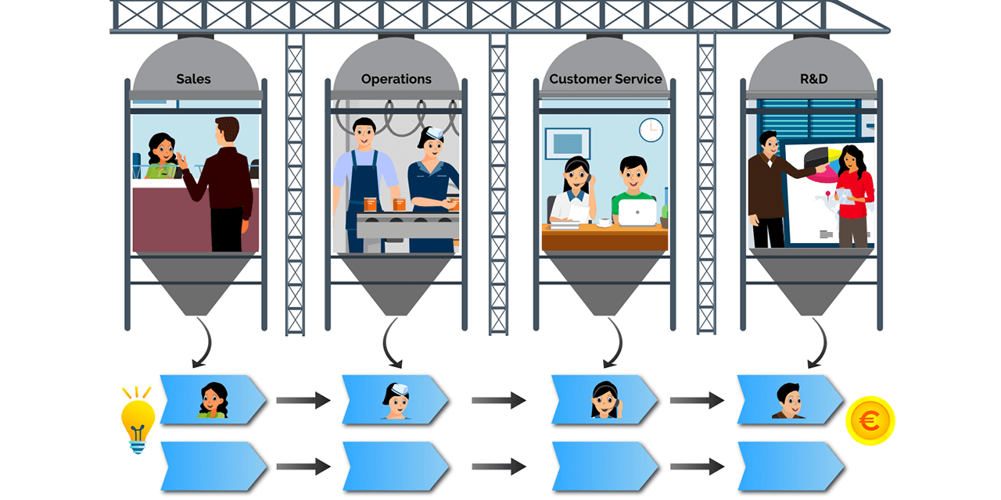
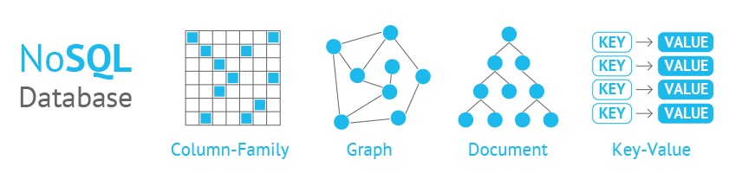
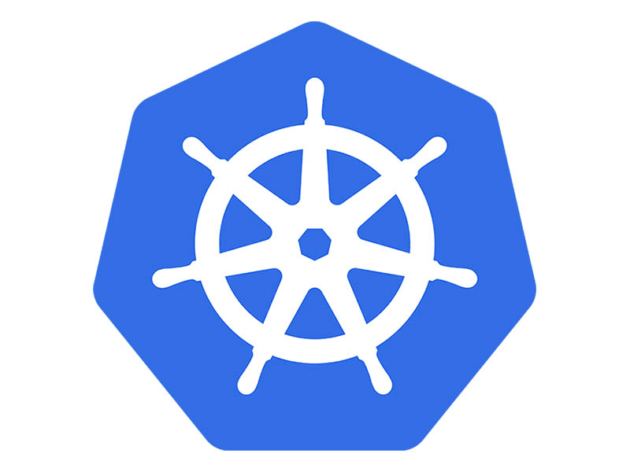
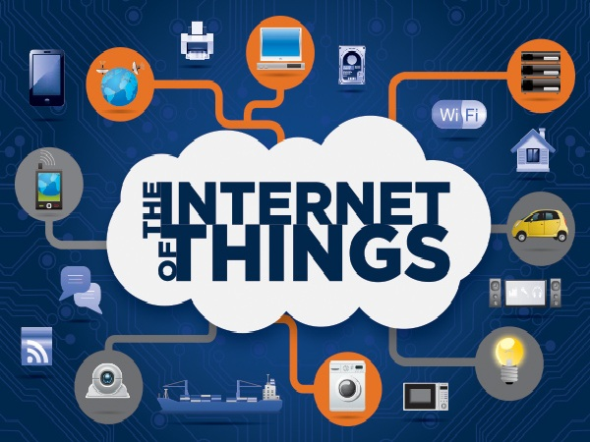

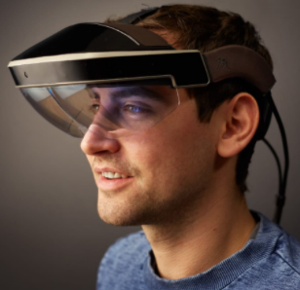
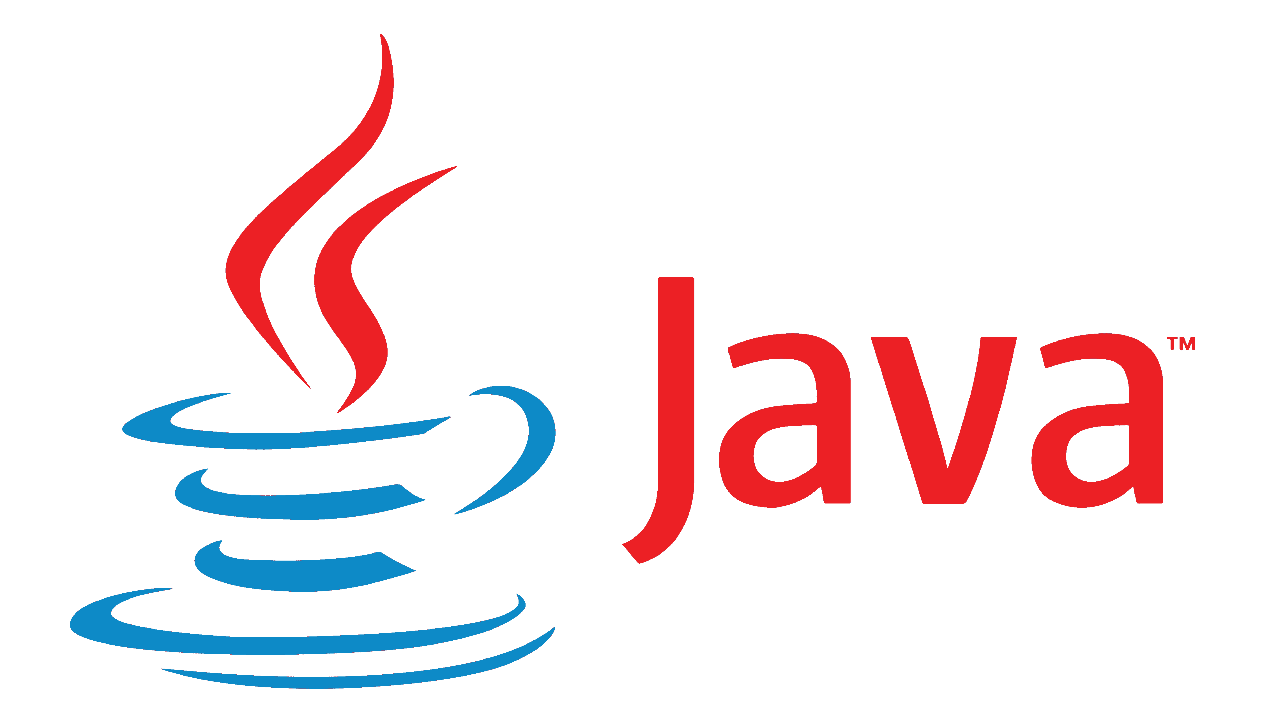
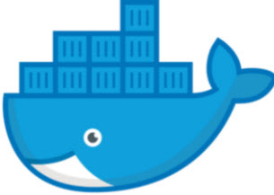
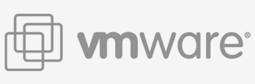


What happened since then?
COTS
DevOps
λ
2000
2010
2020

Slide 26
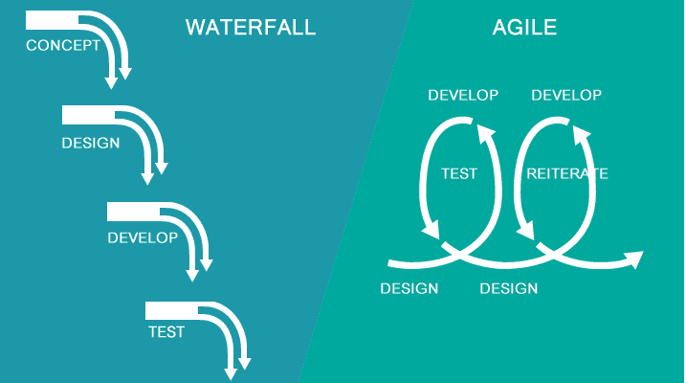

What happened since then?
Agile:
agility, “embrace change”
focus on business value
frequent releases

Slide 27

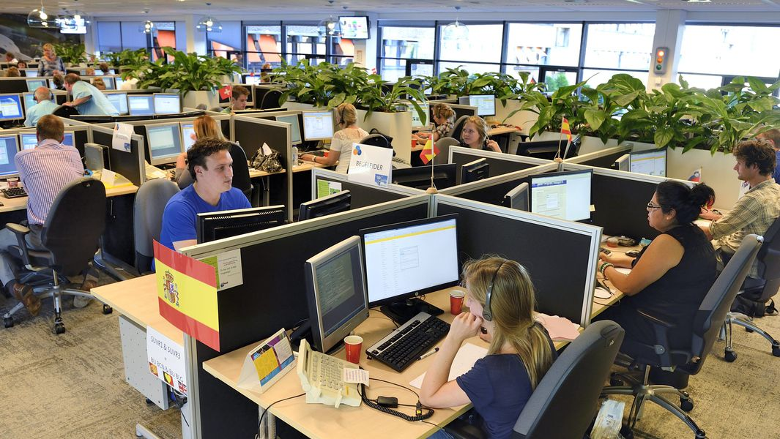

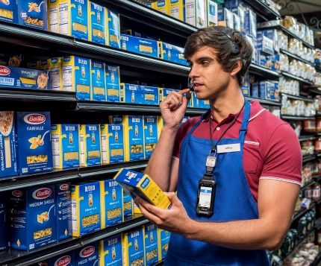


What happened since then?
Apps
24/7
(near) Real Time
B2C
Web Scale
Security
Regulation

Slide 28
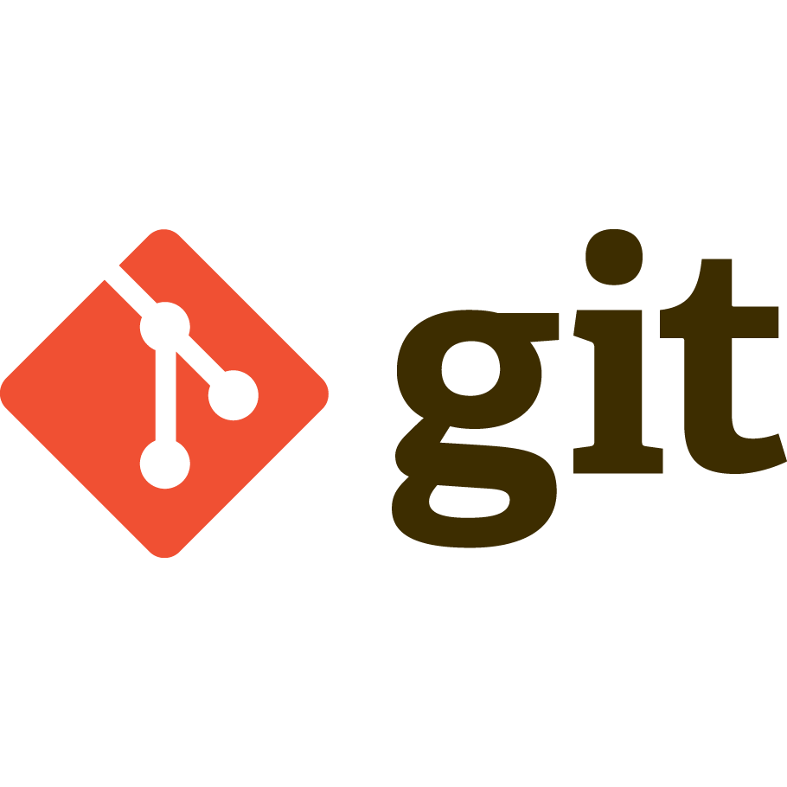
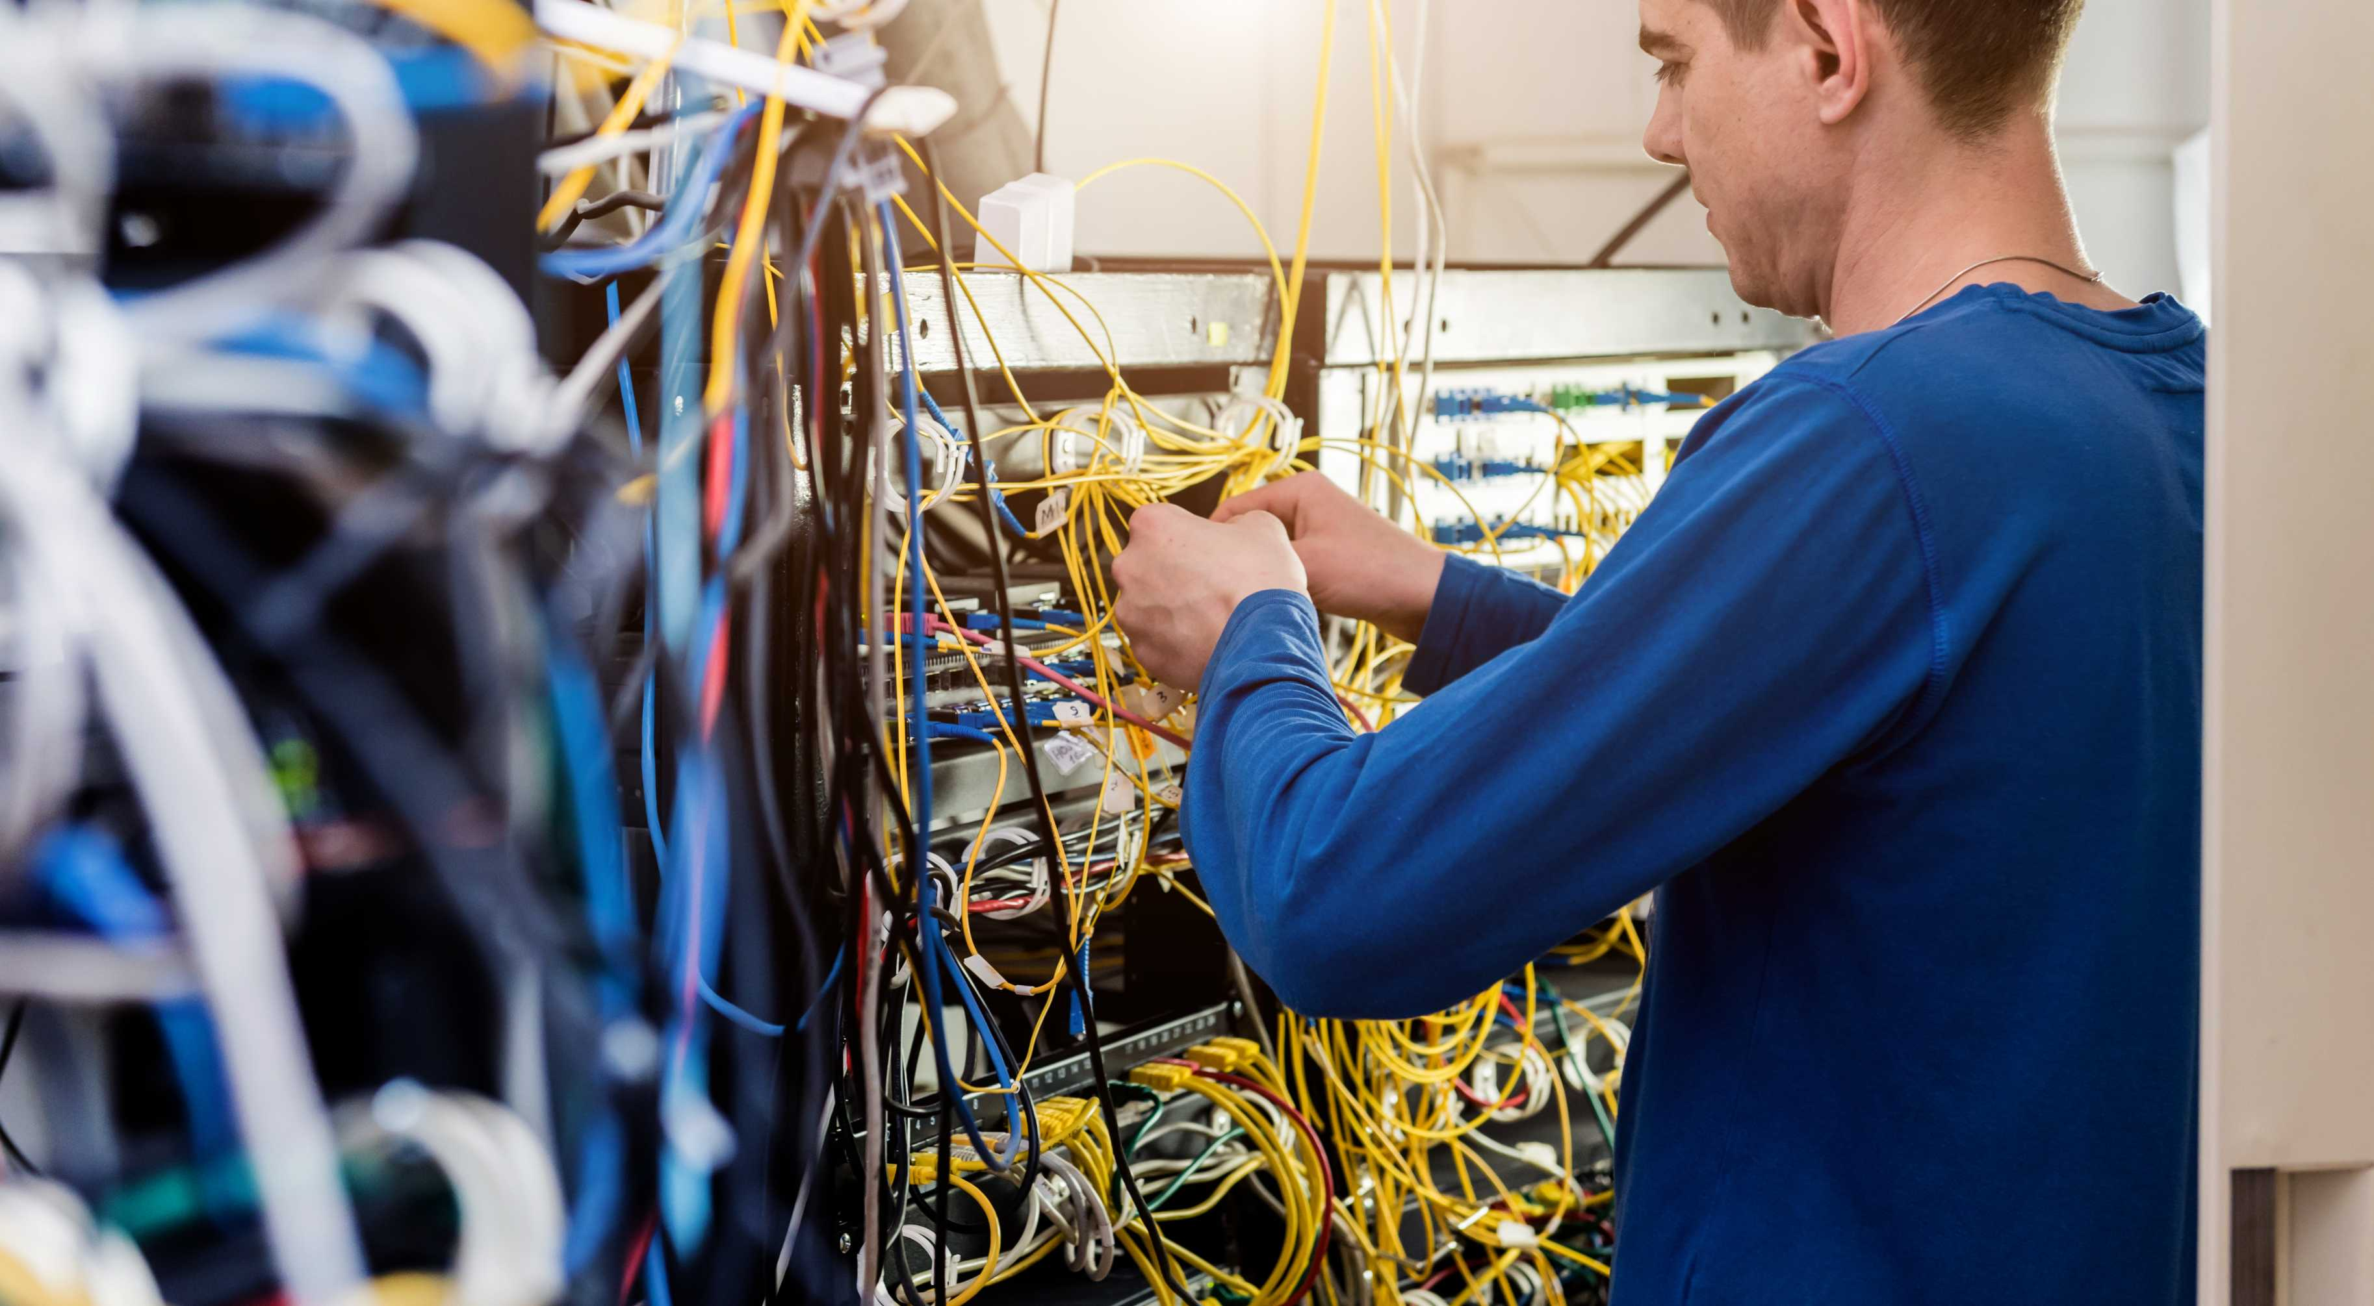

What happened since then?
Virtualization of infrastructure (software defined everything) & infrastructure as code
Notes:
& declarative in plaats van imperative

Slide 29

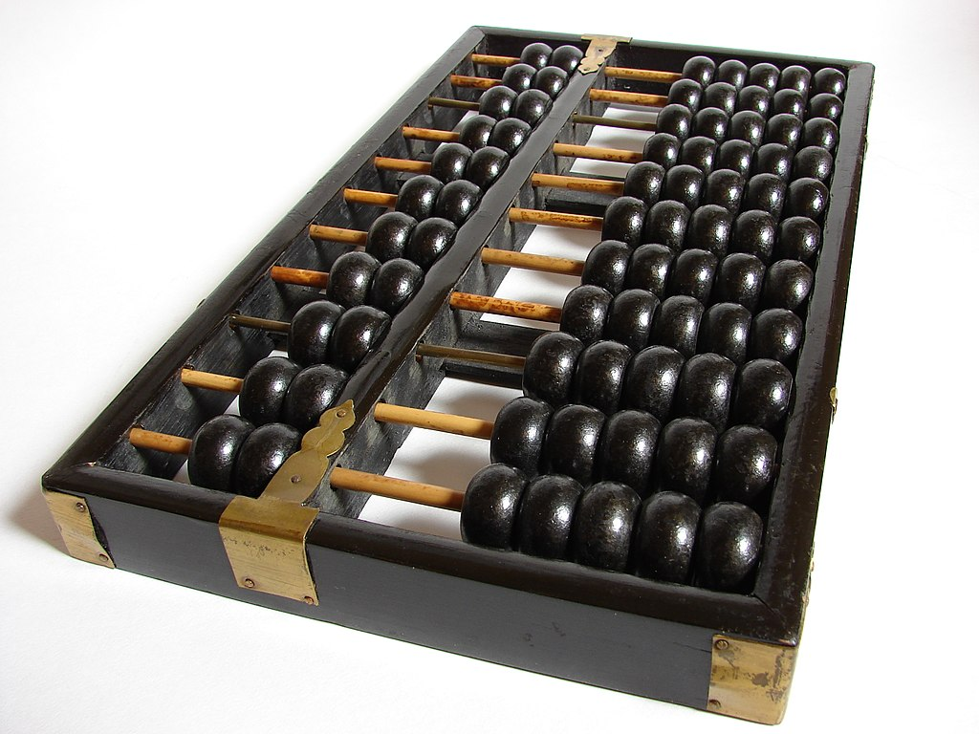

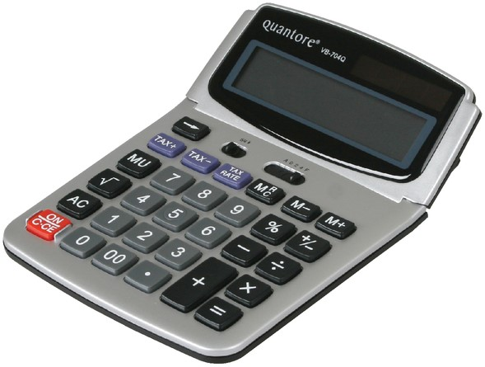
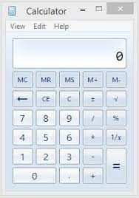

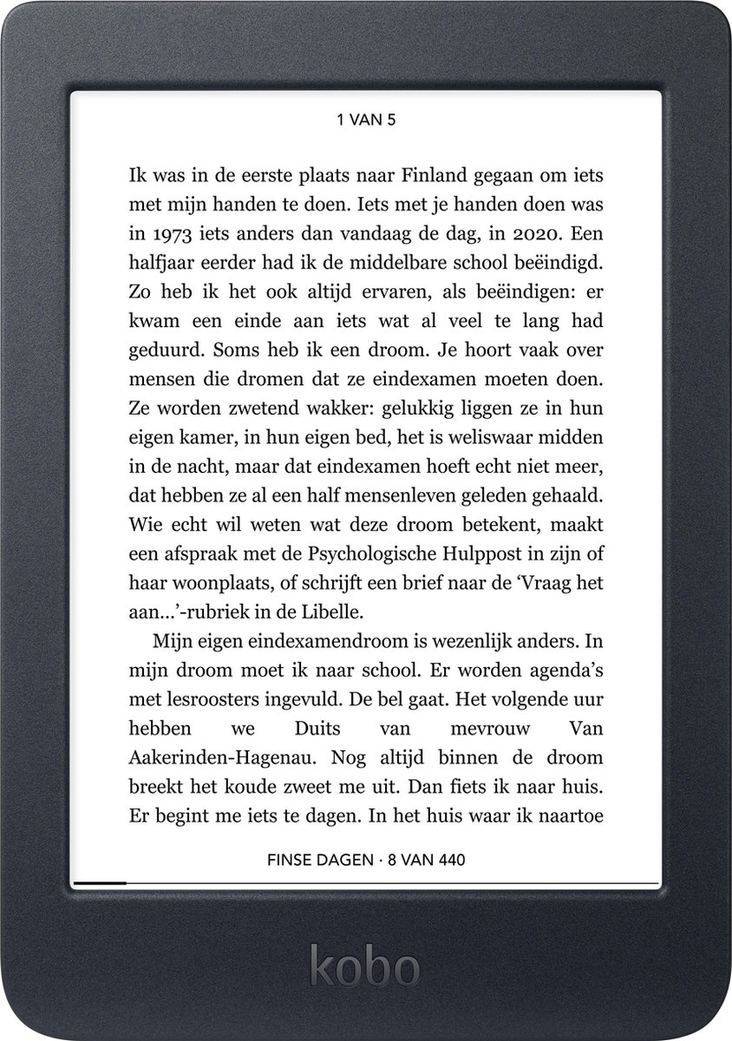
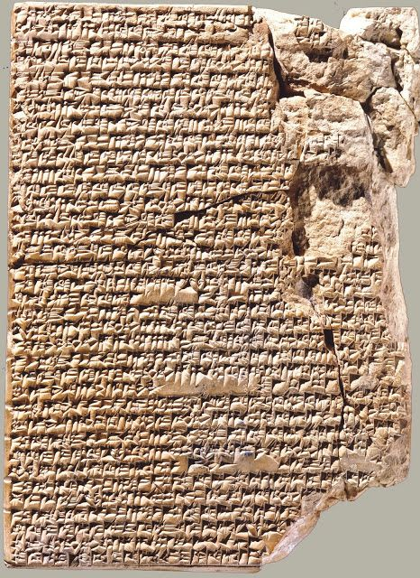
Software Defined… Virtualisation …

Slide 30
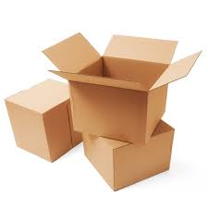
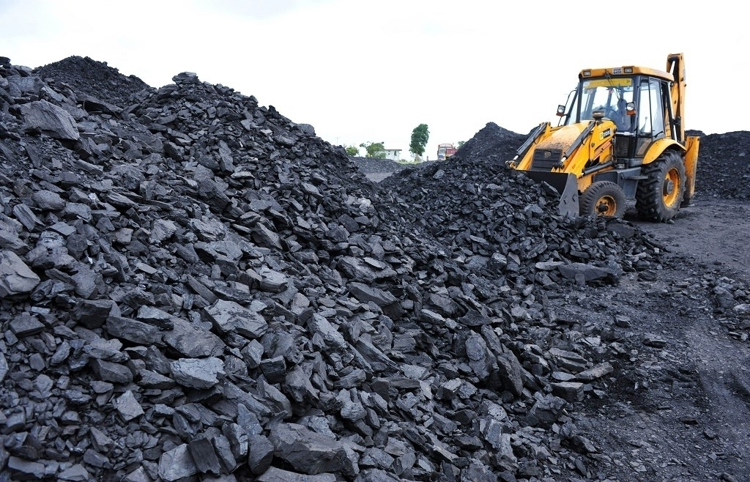

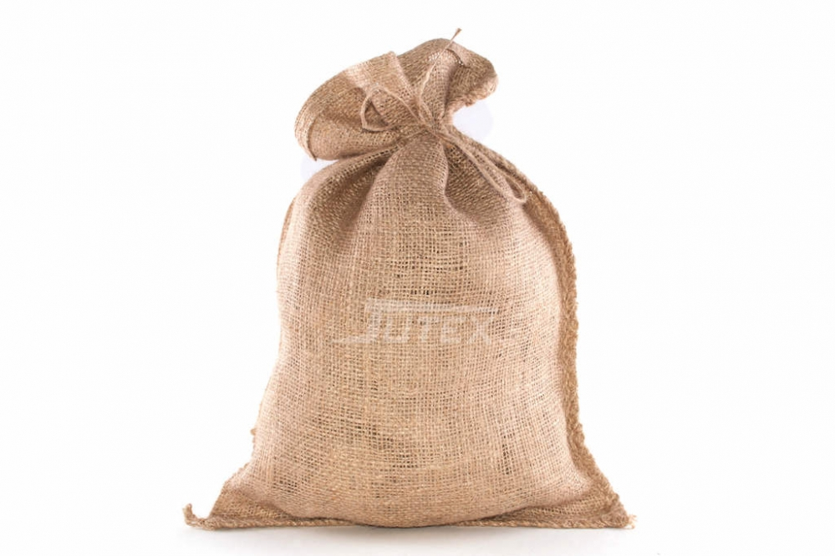
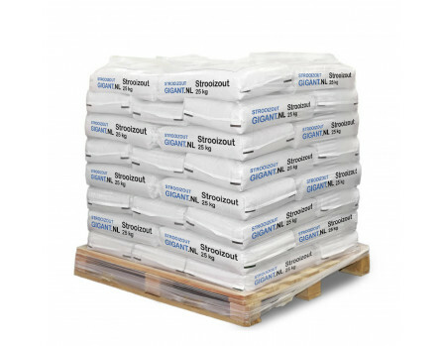
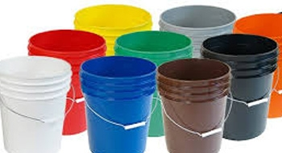
What happened since then?
Containers & Container Platforms
standaardisation of tooling, pipelines and runtime platform
more automation (of IT)– build, distribute, roll out, operate
elastic scalability

Slide 31
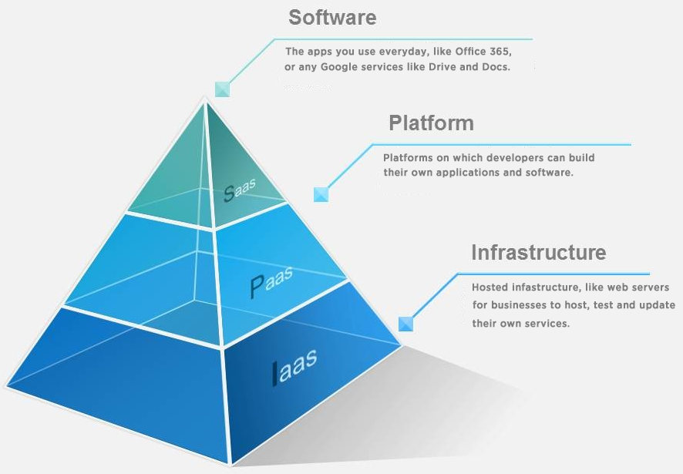
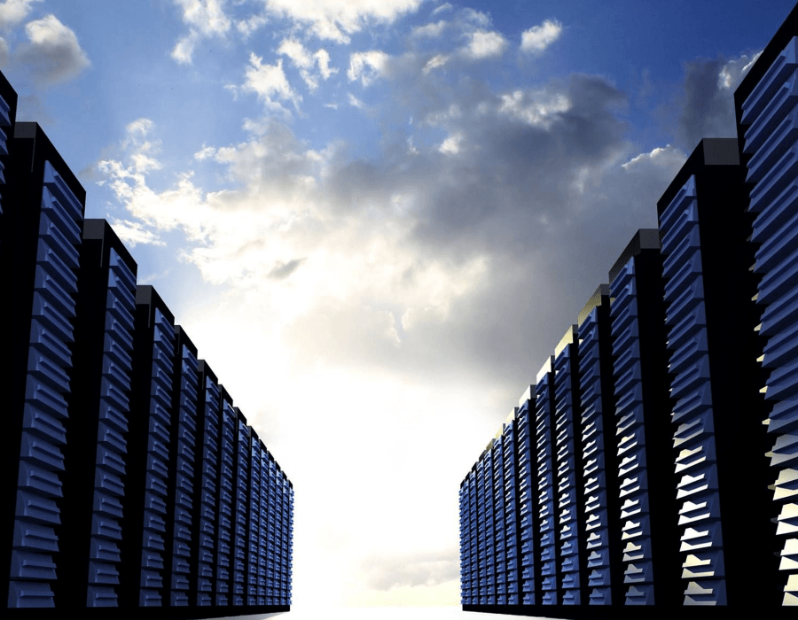
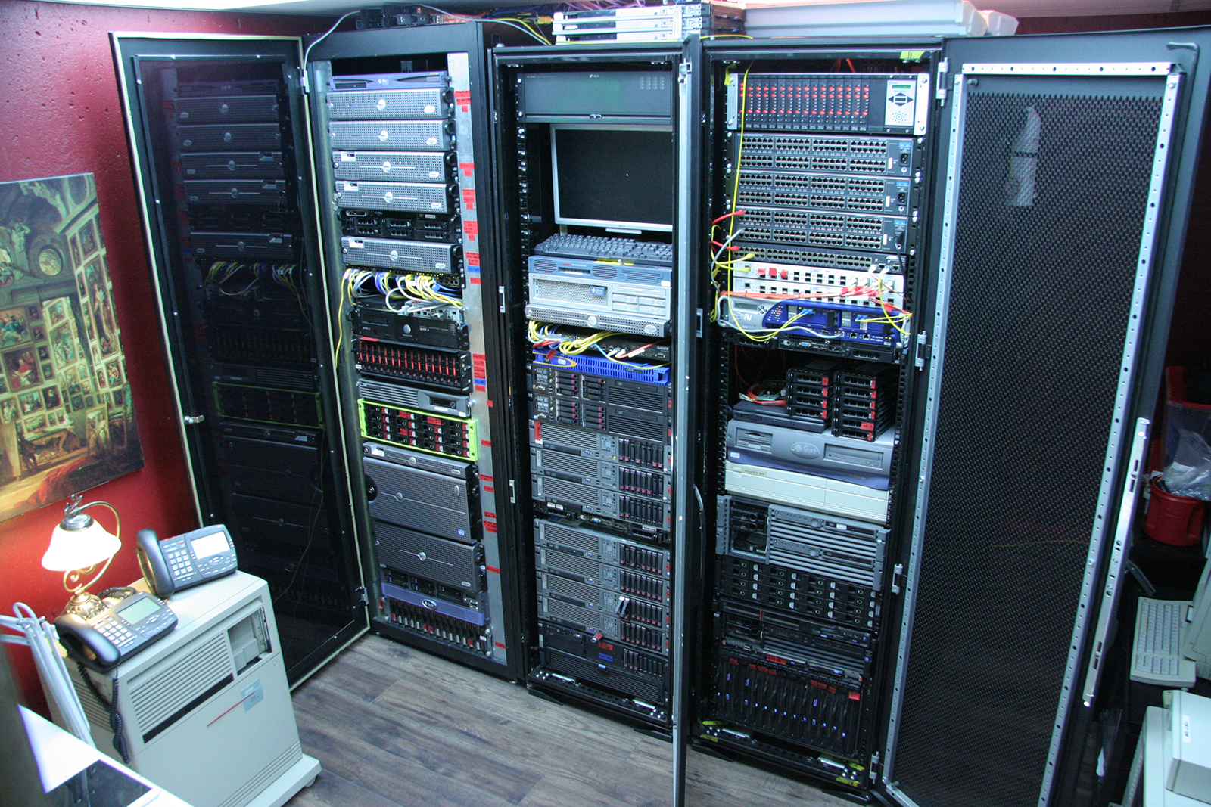
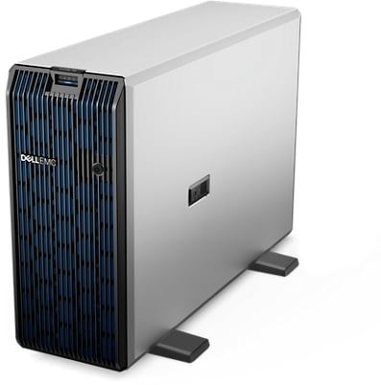

What happened since then?
Cloud
Pay per use – not per high water mark based CAPEX
Speed of Ramp Up
Elasticity in scale
Speed and affordability of innovation
Democratization of IT (anyone, anywhere, any scale)
Managed / operated platform & infrastructure services (PaaS & IaaS)
Serverless
λ

Slide 32

What happened since then?
Moving from closed monolith to open microservices
Smaller, independent products
own data set (domain)
decoupled interaction via APIs and events
fully owned by a team through the entire life cycle

Slide 33
What happened since then?
From temporary Project to continuous Product team with full ownership
From closed vertical specialist silos (security, network, DBA, QA/Test, system engineering, web development, integration, …) to stand alone cells organized around business processes or value streams
Shift-Left

Slide 34


What also happened since then?
Notes:
and what dit NOT happen?
technical LCM
technical debt management
rearchitect for new requirements and using new insights and new technology

Slide 35

Once upon a time
high technical debt
business critical
end of scale
high incident rate
no tests, no specs, no docs
no evolution
unsupported
little expertise left on applications and tech stack
old
security-challenged
inflexible
A Typical Oracle customer
not modern
expensive: high TCO
fragile
legacy
custom software
monolith
unattractive technology stack for young talent
business ⬄ IT gap

Slide 36

We ruined the word “Legacy”

Slide 37

We ruined the word “Legacy”

Slide 38

Stuck in a not so good place
Problems
Disappointments
Frustrations
And Oracle always seems to be part of it

Slide 39

That is really what they want to move away from

Slide 40


Any 15-20+ year old IT system
qualifies to be moved away from

Slide 41

What is desired?
A better place
What does that mean?

Slide 42




How to go there?
always

Slide 43






It does not exist

Slide 44

6R Strategy for Finding your Route
Repurchase
SaaS
Replatform
Refactor/Rearchitect
Oracle Cloud PaaS
Any PaaS
Elastic
Autonomous
Database
NoSQL
RDBMS
DWH/
Data Lake
Oracle Cloud IaaS/DBaaS
Any IaaS
Oracle
Database
Oracle
Database
Rehost
Rehost
Analysis of Current Systems
Oracle
Database
Oracle
Database
Retain (& Refurbish)
Retire

Slide 45

My Recommendations
Appreciate the tremendous value in your applications, data(bases), people, processes
consider including it explicitly as assets on your balance sheet
Focus on Business Value provided by IT systems
make sure your IT enables business – it is a means to that end
agile Dev and Ops – short time to market, high release frequency
do custom IT only for company specific and competitively relevant: buy (COTS/SaaS) before reuse before build

Slide 46
My Recommendations - 2
Analyze and Manage Technical and other Debt
software “-abilities”
Modernize Application architecture
“microservices”, decoupling, reduce monolithism
Refine Data architecture
stand-alone domains, interfaces
no sub-interface cross-domain logic (such as FKs)
metadata management and data governance
apply CQRS (command query responsibility) and allow tailor made read only data replicas

Slide 47
My Recommendations - 3
Automate your IT processes
software engineering, platform virtualization, infra as code, CI/CD, no touch Ops
Design for and run on Elastic Platform (dynamic scale up and down by horizontally scaling out and in) and for managed & Pay per Use
Do Life Cycle Management: constant technical and functional evaluation and evolution
know what you have,
what is used and whom and what for,
what value does it generate and what does it cost to operate
what is available in the world around you,
what is the gap and what are the cost and benefit of closing it
keep moving forward and keep talking with business

Slide 48


Backwards Compatibility can make Complacent
After 25 years – my SQL, PL/SQL and Forms skills are still relevant
and even [most of] my code will still run
Kudos to Oracle!
But beware – all of us: do not get complacent
Make sure your code is not backwards compatible

Slide 49

Embrace and Leverage “The New”
Concepts, Patterns, Tools, Ways of Working, Features, Technology
Shame on you if you
are still using (+) for outer join
include DECODE in any SQL you write
type SYSDATE instead of SYSTIMESTAMP
have never tried out WITH clause in your SQL queries

Slide 50



Ora of Success

Slide 51
Help me move away from Oracle…

Slide 52
Help me move away from Oracle to … Oracle

Slide 53


For more information about this Session, please contact:
Lucas Jellema
For details about joining RMOUG, please go to our Join Us Page:
rmoug.org/Join Us
or contact:
Tim Mishek, Membership Director
membershipdir@rmoug.org
lucas.jellema@amis.nl | technology.amis.nl
@lucasjellema | lucas-jellema

